Slide 1
Self-supervision, BERT, and Beyond
Building Transformer-Based Natural Language Processing Applications (Part 2)

Slide 2
FULL COURSE AGENDA
Part 1: Machine Learning in NLP Lecture: NLP background and the role of DNNs leading to the Transformer architecture Lab: Tutorial-style exploration of a translation task using the Transformer architecture
Part 2: Self-Supervision, BERT, and Beyond Lecture: Discussion of how language models with self-supervision have moved beyond the basic Transformer to BERT and ever larger models Lab: Practical hands-on guide to the NVIDIA NeMo API and exercises to build a text classification task and a named entity recognition task using BERT-based language models
Part 3: Production Deployment Lecture: Discussion of production deployment considerations and NVIDIA Triton Inference Server Lab: Hands-on deployment of an example question answering task to NVIDIA Triton

Slide 3
Part 2: Self-Supervision, BERT and Beyond
Lecture
Why Do DNNs Work Well?
Self-Supervised Learning
BERT
Lab
Explore the Data
Explore NeMo
Text Classifier Project
Lecture (cont’d)
The Scaling Laws
Can and should we go even bigger?
Lab (cont’d)
Named Entity Recognizer

Slide 4
Part 2: Self-Supervision, BERT and Beyond
Lecture
Why Do DNNs Work Well?
Self-Supervised Learning
BERT
Lab
Explore the Data
Explore NeMo
Text Classifier Project
Lecture (cont’d)
The Scaling Laws
Can and should we go even bigger?
Lab (cont’d)
Named Entity Recognizer

Slide 5
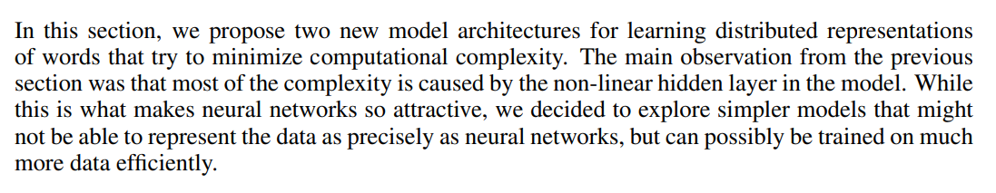
Compute
Or lack of thereof
cat
Σ
E
E
E
E
PAD
the
sat
on
Mikolov, Tomas, et al. "Efficient estimation of word representations in vector space." arXiv preprint arXiv:1301.3781 (2013).

Slide 6
Compute
Easy to forget about the computational progress of the last decades
10⁷
GPU-Computing perf
1.5X per year
1000X
By 2025
10⁶
10⁵
Transistors (thousands)
1.1X per year
10⁴
10³
1.5X per year
10²
Single-threaded perf
Notes:
Fortunately, for the last several decades we have benefited from almost an exponential increase in computational performance. Even though that trend for classical CPU computing clearly is coming to an end, because of the progress in GPU computing we can still benefit from that exponential relationship.

Slide 7
Context

Slide 8
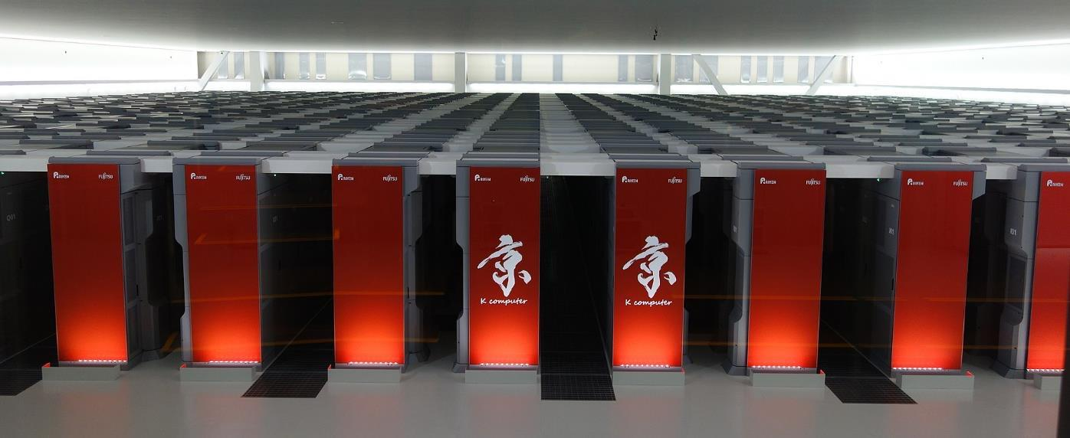
Context
8 petaFLOPs in June 2011 (K Computer)
Notes:
In November 2009 Jaguar system illustrated above constituted the world’s most performant supercomputing cluster and delivered 1.759 PetaFLOPS (that is 10^15 floating point operations per second).

Slide 9
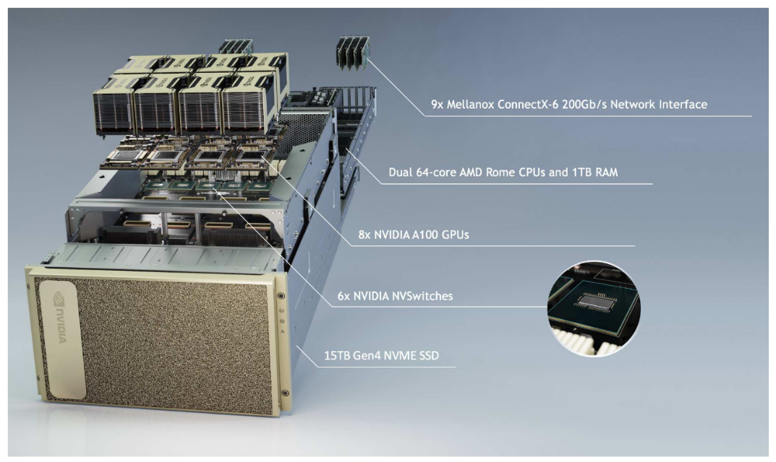
Context
5 petaFLOPs for AI - today
Notes:
Today a single system delivers 2 peta FLOPs for training neural networks.
Computational power accessible only to world’s largest superpowers in November 2009 is now available to everyone due to presence of dense GPU systems in the cloud.
Next slide

Slide 10
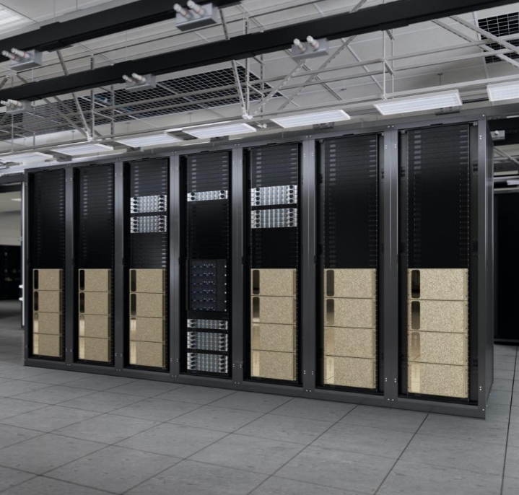
Context
~100 PFLOPS (FP16) or 48 PFLOPS (TF32) for AI - today
Notes:
Today a single system delivers 2 peta FLOPs for training neural networks.
Computational power accessible only to world’s largest superpowers in November 2009 is now available to everyone due to presence of dense GPU systems in the cloud.
Next slide

Slide 11
100 ExaFLOPs ~= 2 years on a dual CPU server

Slide 12
Scaling Laws

Slide 13
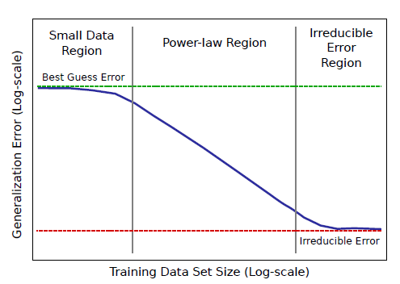
Scaling Laws
Power Law relationship between the dataset size and accuracy
Hestness, J., Narang, S., Ardalani, N., Diamos, G., Jun, H., Kianinejad, H., ... & Zhou, Y. (2017). Deep Learning Scaling is Predictable, Empirically. arXiv preprint arXiv:1712.00409.

Slide 14
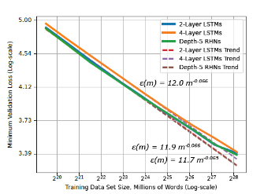
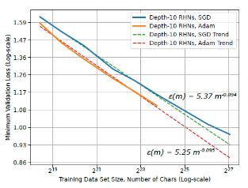
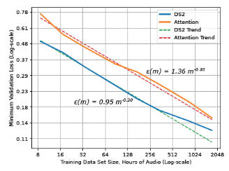
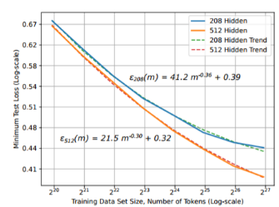
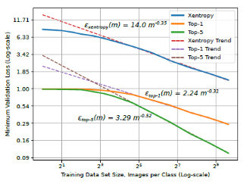
Scaling Laws
Applicable across all AI tasks
Translation
Language Models
Character Language Models
Image Classification
Attention Speech Models
Hestness, J., Narang, S., Ardalani, N., Diamos, G., Jun, H., Kianinejad, H., ... & Zhou, Y. (2017). Deep Learning Scaling is Predictable, Empirically. arXiv preprint arXiv:1712.00409.

Slide 15
The Cost

Slide 16
The cost of Labeling
Limits the utility of deep learning models
Exponential increase
Hestness, J., Narang, S., Ardalani, N., Diamos, G., Jun, H., Kianinejad, H., ... & Zhou, Y. (2017). Deep Learning Scaling is Predictable, Empirically. arXiv preprint arXiv:1712.00409.

Slide 17
Part 2: Self-Supervision, BERT and Beyond
Lecture
Why Do DNNs Work Well?
Self-Supervised Learning
BERT
Lab
Explore the Data
Explore NeMo
Text Classifier Project
Lecture (cont’d)
The Scaling Laws
Can and should we go even bigger?
Lab (cont’d)
Named Entity Recognizer

Slide 18
Self-Supervised Learning
Example training tasks
Natural Language Processing:
Masked Language Model: We mask a percentage of the input tokens at random (say 15%) and ask the neural network to predict the entire sentence
Next Sentence Prediction: We choose either two consecutive sentences from text, or two random sentences from the text. We ask the neural network to establish whether the two sentences occur one after another.
We use another simpler neural network to replace random words in the sequence and ask the primary neural network to detect which words were replaced (using a GAN like configuration).
Computer Vision:
Contrastive Learning: Randomly modify (crop and resize, flip, distort color, rotate, cut-out, noise, blur, etc.) and either feed the same image, or two randomly selected images, into the neural network, asking it to say whether it is the same image or not
Noisy labels/Self Training: Use labels generated by a weak algorithm (potentially older generation of the target model) to train a target-robust feature extractor
Dai, A. M., & Le, Q. V. (2015). Semi-supervised sequence learning. In Advances in neural information processing systems (pp. 3079-3087).
Chen, T., Kornblith, S., Norouzi, M., & Hinton, G. (2020). A simple framework for contrastive learning of visual representations. arXiv preprint arXiv:2002.05709.
Xie, Q., Hovy, E., Luong, M. T., & Le, Q. V. (2019). Self-training with Noisy Student improves ImageNet classification. arXiv preprint arXiv:1911.04252.

Slide 19
The cost of labeling
Semi-supervised models
Manageable cost
Hestness, J., Narang, S., Ardalani, N., Diamos, G., Jun, H., Kianinejad, H., ... & Zhou, Y. (2017). Deep Learning Scaling is Predictable, Empirically. arXiv preprint arXiv:1712.00409.

Slide 20



SeLF-supervised learning
Abundance of unlabeled data

Slide 21
SeLF-supervised learning
Abundance of unlabeled data

Slide 22
Old Ideas

Slide 23
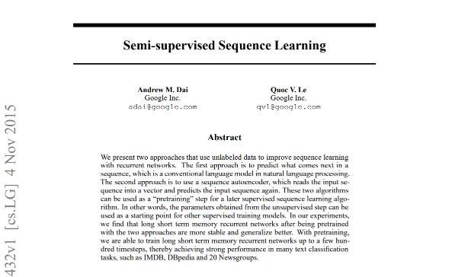
Self-Supervised Learning
What was missing?

Slide 24
The Scale

Slide 25
Generative Pretraining (GPT)
The scale
“Many previous approaches to NLP tasks train relatively small models on a single GPU from scratch. Our approach requires an expensive pre-training step - 1 month on 8 GPUs. Luckily, this only has to be done once and we’re releasing our model so others can avoid it. It is also a large model (in comparison to prior work) and consequently uses more compute and memory — we used a 37-layer (12 block) Transformer architecture, and we train on sequences of up to 512 tokens. Most experiments were conducted on 4 and 8 GPU systems. The model does fine-tune to new tasks very quickly which helps mitigate the additional resource requirements.”
Radford, A., Narasimhan, K., Salimans, T., & Sutskever, I. (2018). Improving language understanding by generative pre-training. URL https://s3-us-west-2. amazonaws. com/openai-assets/researchcovers/languageunsupervised/language understanding paper. pdf.

Slide 26
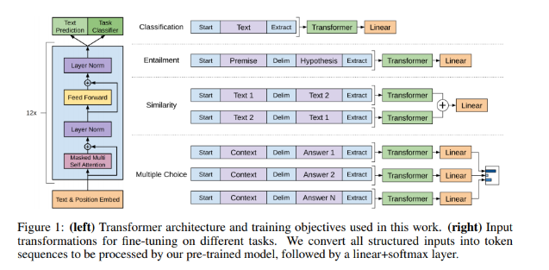
Generative Pretraining (GPT)
The design
Transformer
Decoder
Self-Supervised
Training
Radford, A., Narasimhan, K., Salimans, T., & Sutskever, I. (2018). Improving language understanding by generative pre-training. URL https://s3-us-west-2. amazonaws. com/openai-assets/researchcovers/languageunsupervised/language understanding paper. pdf.

Slide 27
It became possible to transfer learn!

Slide 28
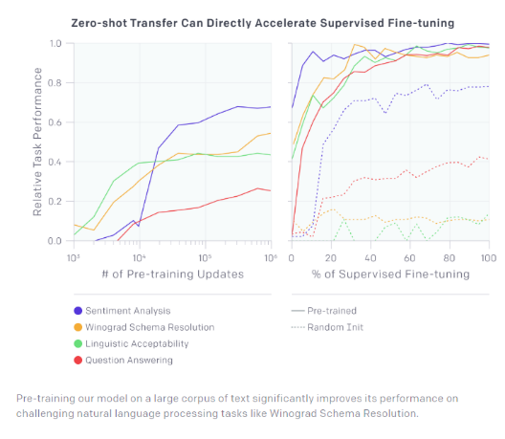
Generative Pretraining (GPT)
The approach
Step 1
Step 2
Radford, A., Narasimhan, K., Salimans, T., & Sutskever, I. (2018). Improving language understanding by generative pre-training. URL https://s3-us-west-2. amazonaws. com/openai-assets/researchcovers/languageunsupervised/language understanding paper. pdf.

Slide 29
Generative Pretraining (GPT)
The implications
Radford, A., Narasimhan, K., Salimans, T., & Sutskever, I. (2018). Improving language understanding by generative pre-training. URL https://s3-us-west-2. amazonaws. com/openai-assets/researchcovers/languageunsupervised/language understanding paper. pdf.

Slide 30
And it worked very well

Slide 31
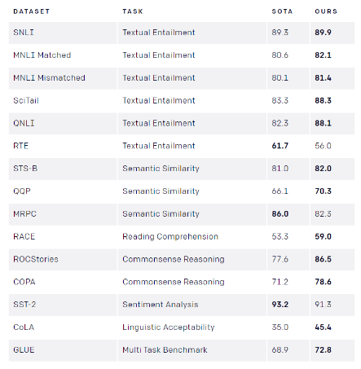
Generative Pretraining (GPT)
The implications
Radford, A., Narasimhan, K., Salimans, T., & Sutskever, I. (2018). Improving language understanding by generative pre-training. URL https://s3-us-west-2. amazonaws. com/openai-assets/researchcovers/languageunsupervised/language understanding paper. pdf.

Slide 32
Part 2: Self-Supervision, BERT and Beyond
Lecture
Why Do DNNs Work Well?
Self-Supervised Learning
BERT
Lab
Explore the Data
Explore NeMo
Text Classifier Project
Lecture (cont’d)
The Scaling Laws
Can and should we go even bigger?
Lab (cont’d)
Named Entity Recognizer

Slide 33
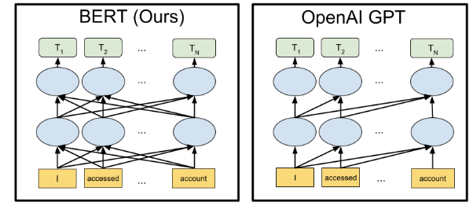
Bidirectional Transformers (BERT)
Building on the shoulders of giants
Devlin, J., Chang, M. W., Lee, K., & Toutanova, K. (2018). Bert: Pre-training of deep bidirectional transformers for language understanding. arXiv preprint arXiv:1810.04805.

Slide 34
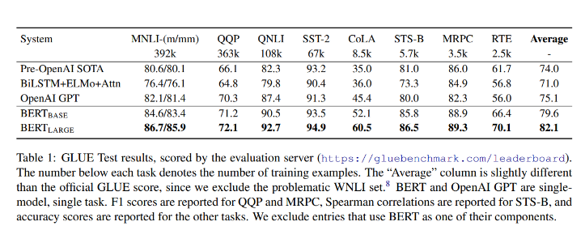
Bidirectional Transformers (BERT)
The “pre” and “post” OpenAI ages
Devlin, J., Chang, M. W., Lee, K., & Toutanova, K. (2018). Bert: Pre-training of deep bidirectional transformers for language understanding. arXiv preprint arXiv:1810.04805.

Slide 35
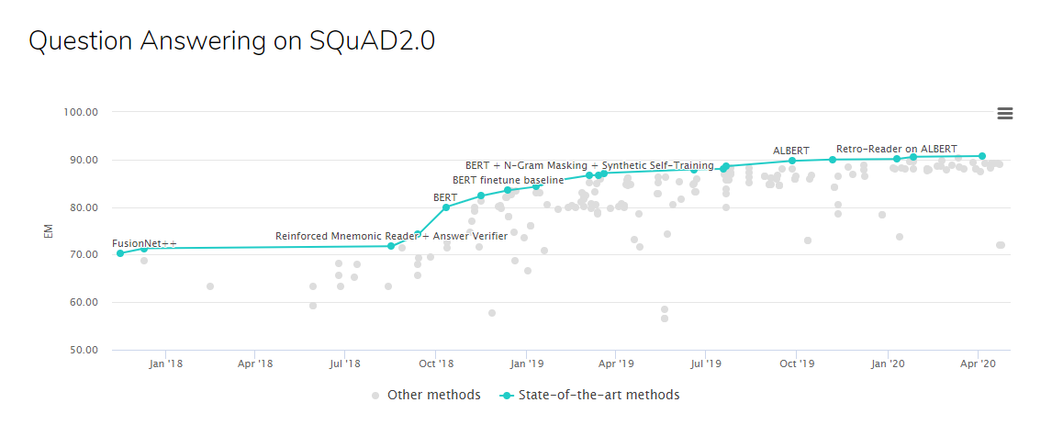
SQUAD 2.0
Human performance 91.2

Slide 36
Just yet another unsupervised representation

Slide 37
Using BERT
Feature extractor
?
Problem formulation
?
?
?
?
?
?
Machine Learning Algorithm
Text Pre-processing
Text Representation
Reweighting
Dimensionality Reduction
Vector Comparison
Text
GloVe
Word2Vec
BERT

Slide 38
The Lab

Slide 39
Lab Overview
Notebooks 1, 2, 3
Text classification
Problem formulation
Machine Learning Algorithm
Text Pre-processing
Text Representation
Reweighting
Dimensionality Reduction
Vector Comparison
Text
Your task:
Text classification
Fixed pretrained BERT

Slide 40
Part 2: Self-Supervision, BERT and Beyond
Lecture
Why Do DNNs Work Well?
Self-Supervised Learning
BERT
Lab
Explore the Data
Explore NeMo
Text Classifier Project
Lecture (cont’d)
The Scaling Laws
Can and should we go even bigger?
Lab (cont’d)
Named Entity Recognizer

Slide 41
Part 2: Self-Supervision, BERT and Beyond
Lecture
Why Do DNNs Work Well?
Self-Supervised Learning
BERT
Lab
Explore the Data
Explore NeMo
Text Classifier Project
Lecture (cont’d)
The Scaling Laws
Can and should we go even bigger?
Lab (cont’d)
Named Entity Recognizer

Slide 42
Bidirectional Transformers (BERT)
Base vs Large
Devlin, J., Chang, M. W., Lee, K., & Toutanova, K. (2018). Bert: Pre-training of deep bidirectional transformers for language understanding. arXiv preprint arXiv:1810.04805.

Slide 43
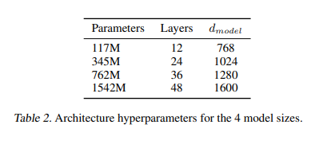
GPT-2
GPT vs GPT-2
Largely the same but:
Larger in every way:
More decoder layers: 12->48
Larger vocabulary: 50,257
Larger context: 512 -> 1024
Larger batch size
Changes to layer normalization
Different initialization scheme
Radford, A., Wu, J., Child, R., Luan, D., Amodei, D., & Sutskever, I. (2019). Language models are unsupervised multitask learners. OpenAI Blog, 1(8), 9.

Slide 44
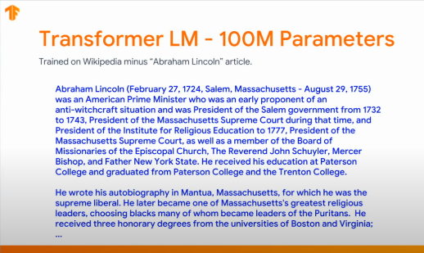
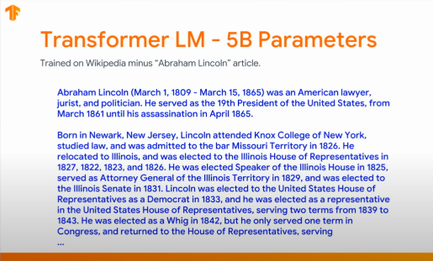
GPT-2
The Impact
Radford, A., Wu, J., Child, R., Luan, D., Amodei, D., & Sutskever, I. (2019). Language models are unsupervised multitask learners. OpenAI Blog, 1(8), 9.

Slide 45
Measurable improvement

Slide 46
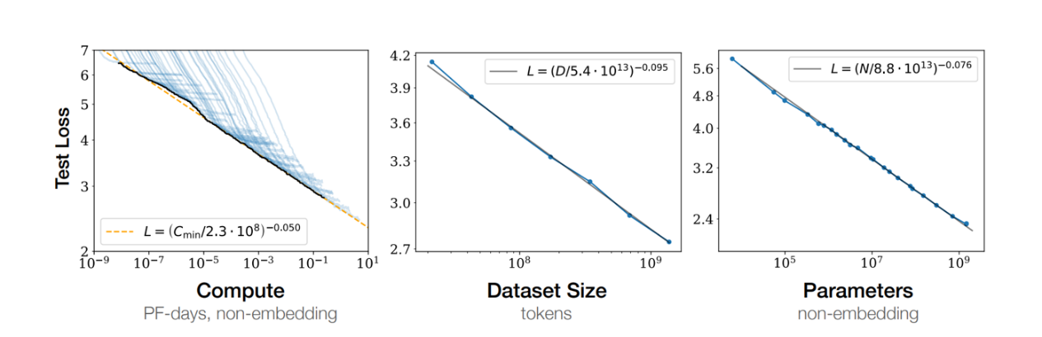
The scaling laws of Neural Language Models
Continuous improvement
Hestness, J., Narang, S., Ardalani, N., Diamos, G., Jun, H., Kianinejad, H., ... & Zhou, Y. Deep Learning Scaling is Predictable, Empirically. arXiv preprint arXiv:1712.00409. 2017
Tom Henighan, Jared Kaplan, Mor Katz, Mark Chen, Christopher Hesse, Jacob Jackson, Heewoo Jun, Tom B. Brown, Prafulla Dhariwal, Scott Gray, Chris Hallacy, Benjamin Mann, Alec Radford, Aditya Ramesh, Nick Ryder, Daniel M. Ziegler, John Schulman, Dario Amodei, Sam McCandlish. Scaling Laws for Autoregressive Generative Modeling.2020
Notes:
We continue to see Scaling laws apply

Slide 47
Part 2: Self-Supervision, BERT and Beyond
Lecture
Why Do DNNs Work Well?
Self-Supervised Learning
BERT
Lab
Explore the Data
Explore NeMo
Text Classifier Project
Lecture (cont’d)
The Scaling Laws
Can and should we go even bigger?
Lab (cont’d)
Named Entity Recognizer

Slide 48
Should we build larger models?

Slide 49
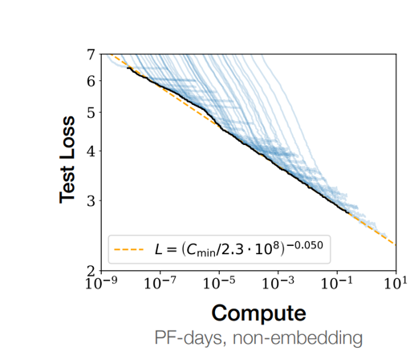
Are Large language models worth it?
The cost of incremental improvement
Are we building those models only for the small incremental improvement in their performance?
Is it worth all of the engineering and computational investment?

Slide 50
Is this really the only thing we have achieved?

Slide 51
It is much more than just incremental increase in accuracy!

Slide 52
1. Sample Efficiency

Slide 53
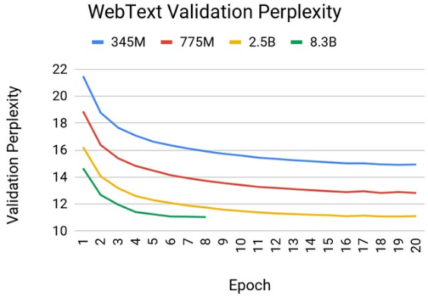
Not about incremental improvement
Sample efficiency
Shoeybi, M., Patwary, M., Puri, R., LeGresley, P., Casper, J., & Catanzaro, B. (2019). Megatron-lm: Training multi-billion parameter language models using gpu model parallelism. arXiv preprint arXiv:1909.08053.

Slide 54
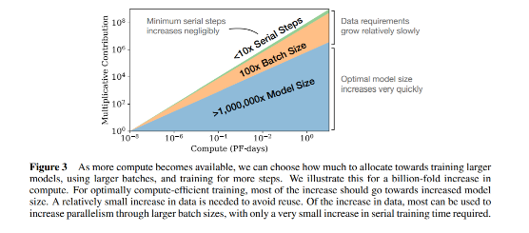
Larger models are cheaper to train
Optimal allocation of computational budget
Kaplan, J., McCandlish, S., Henighan, T., Brown, T. B., Chess, B., Child, R., ... & Amodei, D. (2020). Scaling Laws for Neural Language Models. arXiv preprint arXiv:2001.08361.

Slide 55
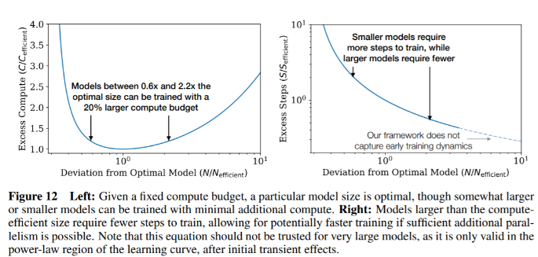
Larger models are cheaper to train
For every dataset there exists an optimal model size minimizing compute
Kaplan, J., McCandlish, S., Henighan, T., Brown, T. B., Chess, B., Child, R., ... & Amodei, D. (2020). Scaling Laws for Neural Language Models. arXiv preprint arXiv:2001.08361.

Slide 56
2. Architectural hyperparameters

Slide 57
Large models are cheaper to design
Impact of architectural hyperparameters
“… more importantly, we find that the precise architectural hyperparameters are unimportant compared to the overall scale of the language model.”
Kaplan, J., McCandlish, S., Henighan, T., Brown, T. B., Chess, B., Child, R., ... & Amodei, D. (2020). Scaling Laws for Neural Language Models. arXiv preprint arXiv:2001.08361.

Slide 58

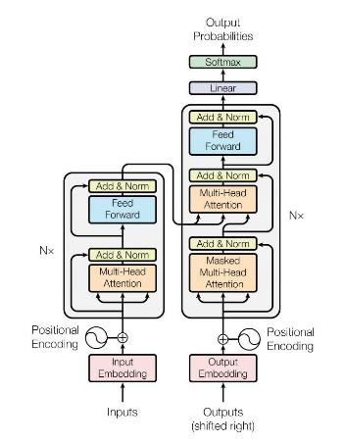
NLP APPROACH (CIRCA 2019)
Step 1: Pre-training a Transformer
Step 2. Fine tune for a specific task
Output
Output 1: Reconstruct missing words
Labelled Data
family, of, this, the, Louis, personally, telephone
Classifier
High dimensional vector
Decoder
High dimensional vector
Decoder
Encoder
Encoder
Input: Two sentences with 15% of words masked out
1 = “Initially he supported himself and his family by farming on a plot of family land.”
2 = “This in turn attracted the attention of the St. Louis Post-Dispatch, which sent a reporter to Murray to personally review Stubblefield's wireless telephone.”

Slide 59
3. Generalization

Slide 60
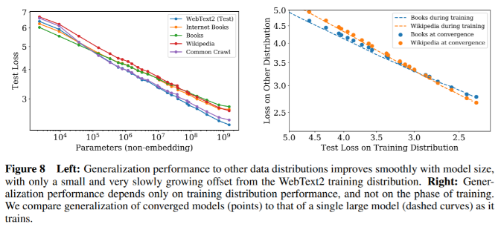
Yes they create incremental improvement in accuracy
Larger models generalize better
Kaplan, J., McCandlish, S., Henighan, T., Brown, T. B., Chess, B., Child, R., ... & Amodei, D. (2020). Scaling Laws for Neural Language Models. arXiv preprint arXiv:2001.08361.
Notes:
Studies showed that applying those model into other data distribution showed good results on generalization

Slide 61
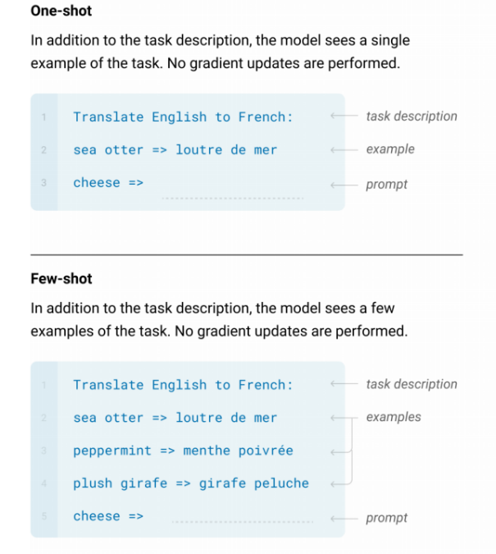
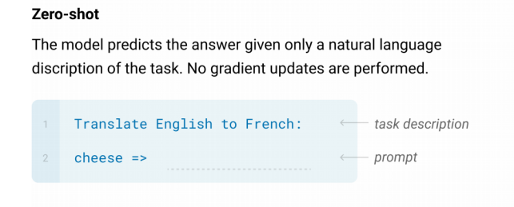
Downstream Tasks
Zero/Few Shot Learners
Benjamin Mann et al. "Language Models are Few-Shot Learners". 2020. https://arxiv.org/abs/2005.14165
Notes:
There are several ways of querying the LM
In zero shot mode, we just formulate the task and the query as show here for translation
For 1 shot, we explicitly add 1 example of the task
Few shots will consists in adding few examples of the task before the prompt

Slide 62
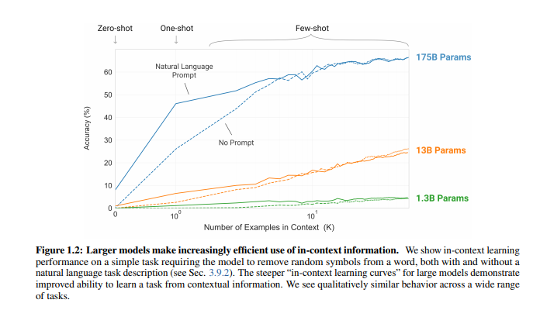
Downstream Tasks
Zero/Few Shot Learners
Shoeybi, M., Patwary, M., Puri, R., LeGresley, P., Casper, J., & Catanzaro, B. (2019). Megatron-lm: Training multi-billion parameter language models using gpu model parallelism. arXiv preprint arXiv:1909.08053
Brown, T. B., Mann, B., Ryder, N., Subbiah, M., Kaplan, J., Dhariwal, P., ... & Agarwal, S. (2020). Language models are few-shot learners. arXiv preprint arXiv:2005.14165..

Slide 63
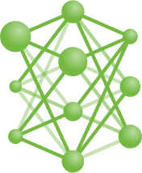
Downstream Tasks
Zero/Few Shot Learners
Q: Would you say this movie review is positive or negative?
“I loved that movie”’
positive
great
awsome …
Prompt
Notes:
NEW:
How to design the prompt?

Slide 64
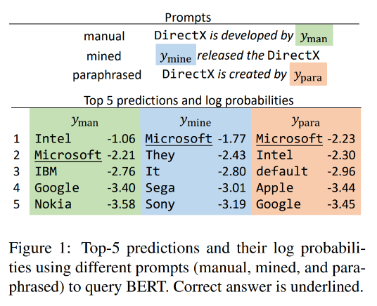
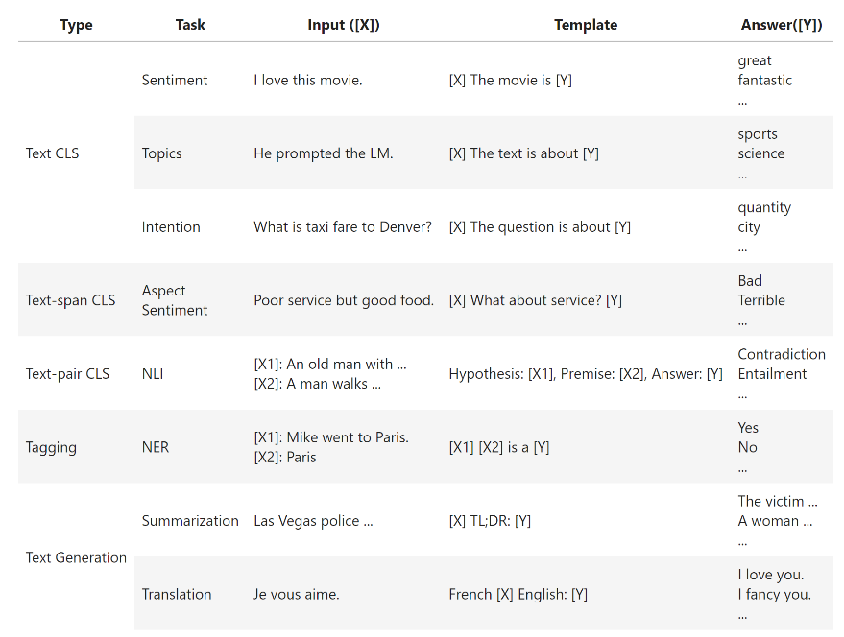
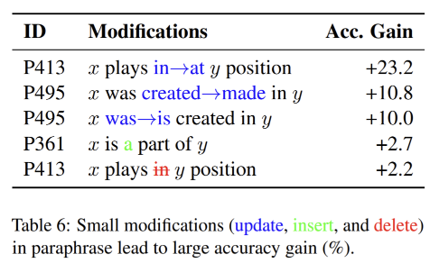
Downstream Tasks
Prompt Engineering
Zhengbao Jiang et al. "How Can We Know What Language Models Know?".2020.
Notes:
We can manually design robust templates for each NLP task.
On the left see some templates examples.
However, models are very sensitive the way we design the prompt.
On the right, prompt engineering paper showing that minor modifications in the prompt such as replacing
x was created in by Y
To x is created by Y lead to a significant improvement of the accuracy
How to choose the best prompt?
Some techniques relies on greedy search in the discrete space of tokens

Slide 65


Downstream Tasks
Prompt Learning on a Small Training Dataset
Learned soft Prompt
Task: Sentiment Analysis
[0.252454, 5.414523, 2.349844]
[0.252454, 5.414523, 2.349844]
“I loved that movie”’
Positive
Q: Would you say this movie review is positive or negative?
“I loved that movie”’
Prompt Learning
Notes:
NEW:
Prompt tuning techniques suggests optimizing the task description in a continuous space
The p-tuning uses a prompt encoder (showed in green ) trained to generate the task representation in a supervised way.
In this case, the task embedding is tuned for different tasks while the large LM remain the same for different tasks.
This is a great strategy as at the deployment step, as we can deploy the same LLM for several tasks as the specialized embedding are concatenated with the query

Slide 66
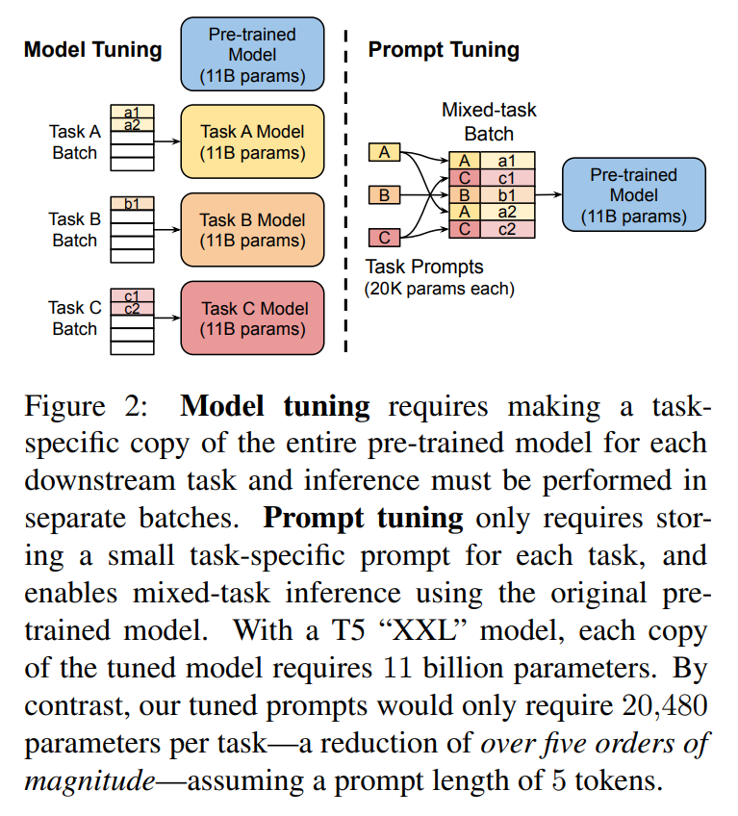
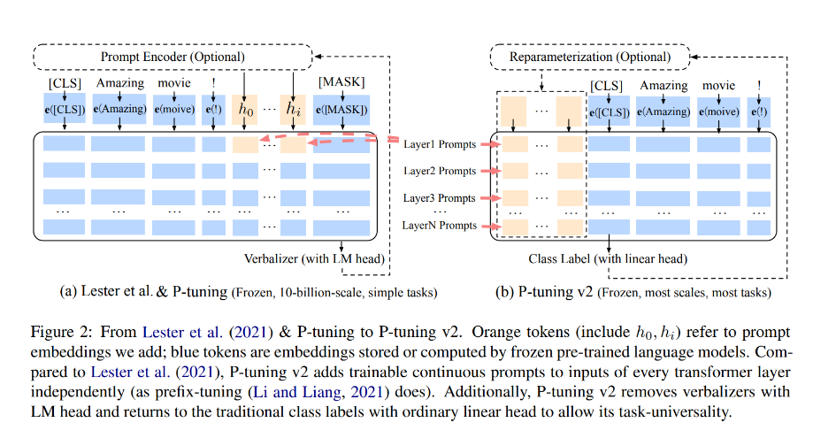
Downstream Tasks
Prompt Tuning / P-Tuning
Brian Lester, Rami Al-Rfou, Noah Constant The Power of Scale for Parameter-Efficient Prompt Tuning. 2021. https://arxiv.org/abs/2104.08691
Xiao Liu et al. " P-Tuning v2: Prompt Tuning Can Be Comparable to Fine-tuning Universally Across Scales and Tasks. 2021. https://arxiv.org/abs/2110.07602​
Notes:
Some papers on Prompt learning

Slide 67
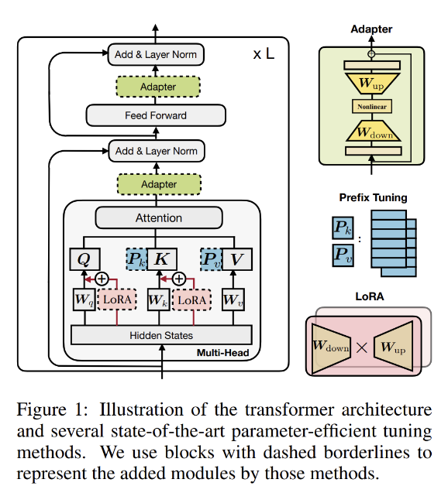
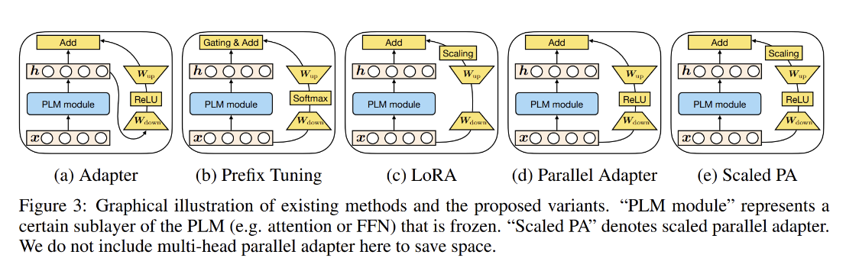
Downstream Tasks
Customize Models using Parameter-efficient tuning | Adapters
Junxian He Chunting Zhou, Xuezhe Ma, Taylor Berg-Kirkpatrick, Graham Neubig. TOWARDS A UNIFIED VIEW OF PARAMETER-EFFICIENT TRANSFER LEARNING. ICLR 2022
Notes:
NEW:
Other techniques suggests to integrate extra parameters called adapter layers inside the LLM architecture.
Adapters require training a small set parameters compared to LLM and thus can be much more efficient to fine-tune.
There are several flavours of adapters finetuning, but basically they consist in residual Feedforward layers compressing and decompressing the input dimension.

Slide 68
Instructed LLM
Notes:
NEW:

Slide 69
Instructions Finetuning
Dataset of Instructions (Queries and Answers)
Joseph Robinette Biden Jr. is an American politician who is the 46th and current president of the United States. A member of the Democratic Party, he previously served as the 47th vice president from 2009 to 2017 under President Barack Obama, and represented Delaware in the United States Senate from …”
“Q: Who is the president of USA?
Notes:
NEW:
LLM are trained for next token prediction, not to answer instrurctions.
Suggestion is to finetune the LLM with instructions. (see example)

Slide 70
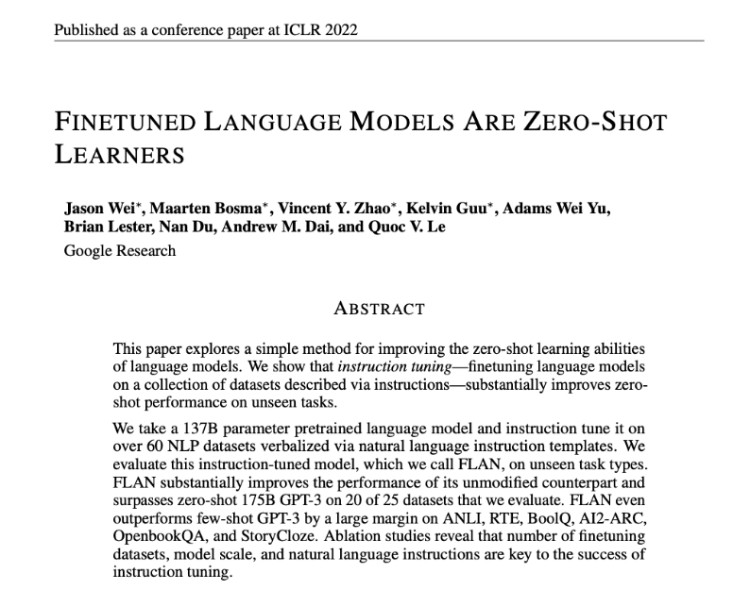
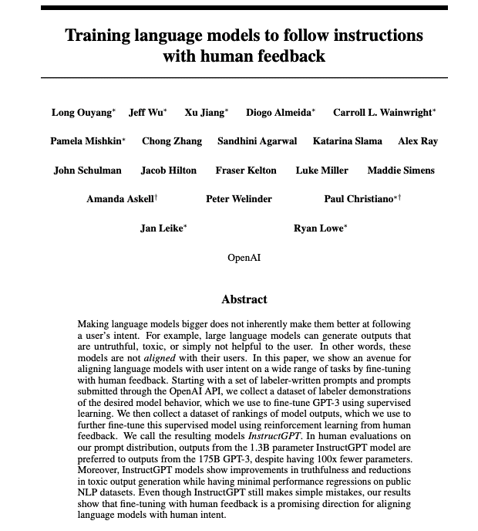
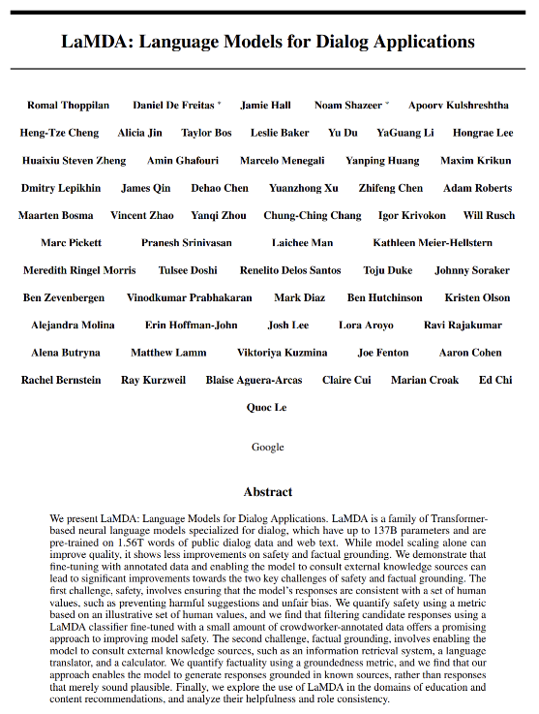
Instructions Finetuning
FLAN [Google ]
InstructGPT [OpenAI ]
LaMDA [Google ]
Notes:
NEW:
Some recent papers

Slide 71
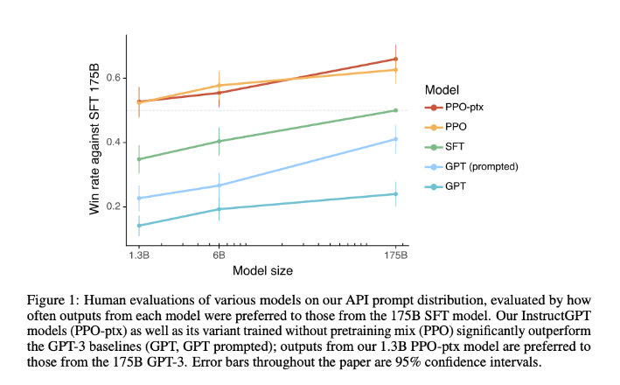
Instructions Finetuning
FLAN [Google ]
InstructGPT [OpenAI ]
LaMDA [Google ]
Notes:
Small scale instructed LLM (1.3B) outperform large a prompted GPT model (175B)

Slide 72
Change in the NLP paradigm

Slide 73



NEW NLP APPROACH (CIRCA 2021)
Step 1: Train a Very Deep/HUGE model
Step 2. Ask questions
General Knowledge
Literature
‘Q: Would you say this movie review is positive or negative? “I loved that movie”’
‘A: Negative’
Science
GitHub
Huge means Billions of parameters

Slide 74
TOWARDS GENERAL INTELLIGENCE
Old way
New way
Needs Labelled data
Cost of data collection/labelling
Legal/Privacy concerns around using data
1 model per task results in
Increased model development/tuning cost
Increased operational costs
Increased money spent on sourcing data
Relatively Limited generalization
Computationally cheaper (~300 Million parameters)
Does not need labelled data
Single generic model can do more than one tasks
More generalized: in addition to language also learns higher level concepts, styles, etc.
Computationally Expensive (~500 Billion parameters)
Leveraging more compute to get a general model without significant data/labelling cost

Slide 75
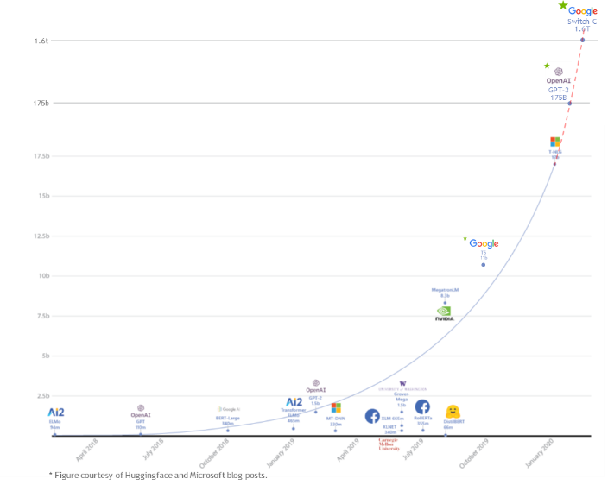

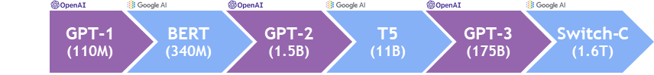
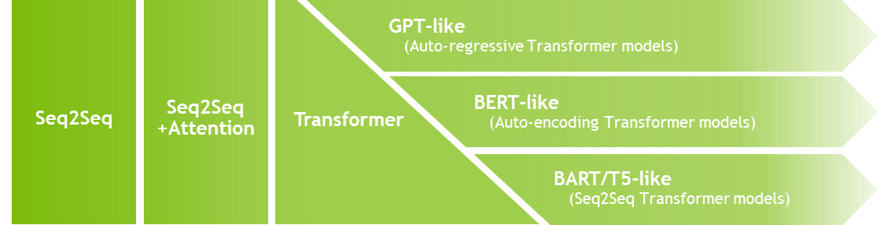
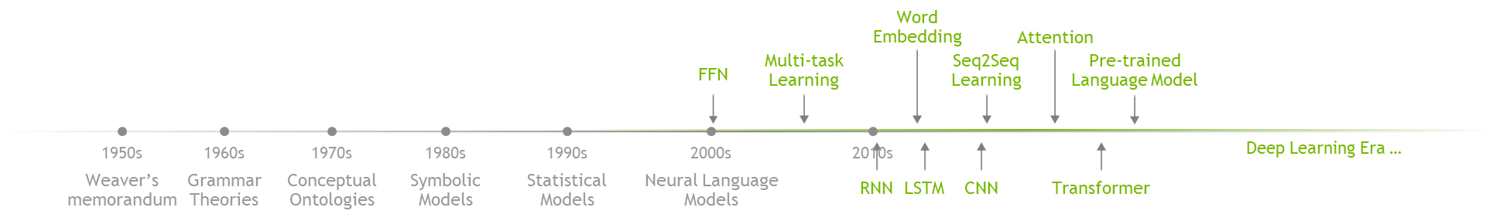
HISTORY OF LANGUAGE MODELS
Language Model became more complex and larger

Slide 76
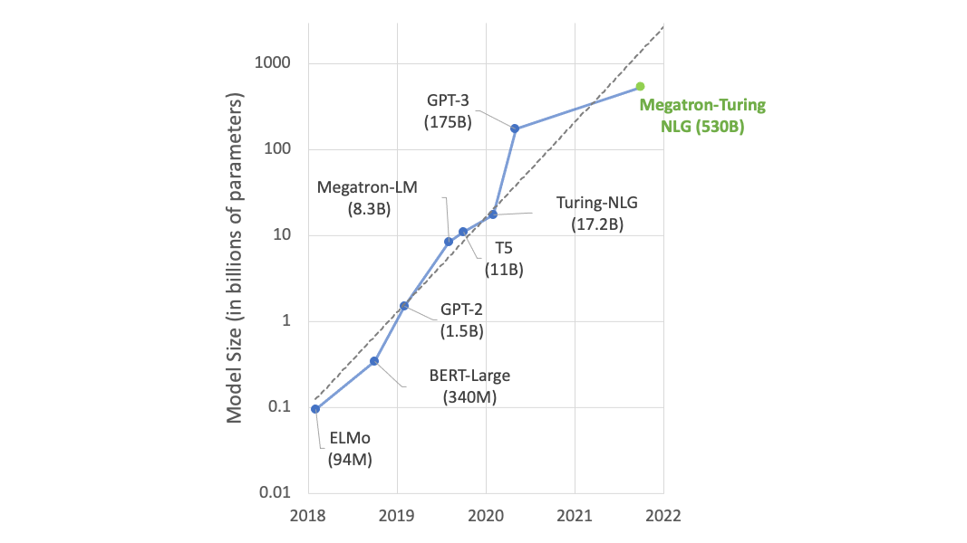
Megatron-Turing NLG 530B
The Trend Continues
https://developer.nvidia.com/blog/using-deepspeed-and-megatron-to-train-megatron-turing-nlg-530b-the-worlds-largest-and-most-powerful-generative-language-model/

Slide 77
LLM for search
Notes:
NEW:
How to ensure accurate outputs?

Slide 78

external knowledge source
Instructed LLM
Knowledge source
Notes:
NEW:
Use external knowledge and Search

Slide 79
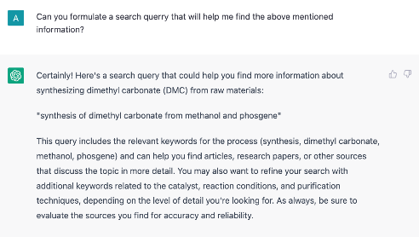
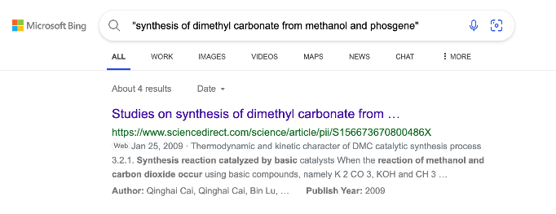
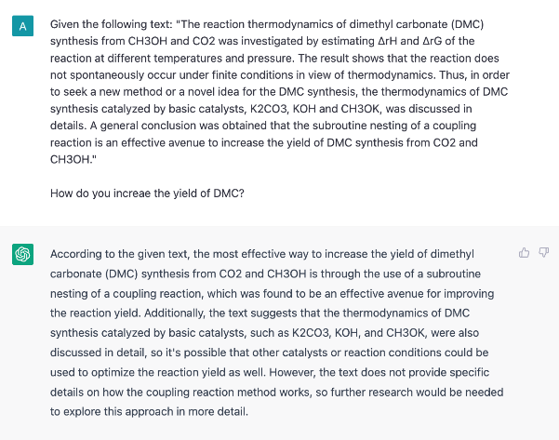
external knowledge source
Searching through the web
Notes:
NEW:
Example: Use LLM to gather several content and then generate an answer from that

Slide 80


external knowledge source
Examples of Search Engine Powered by LLM
NORA - No One Right Answer [Google]
New Bing Search Engine [Microsoft]
Notes:
NEW:
Example of recently announced new search engines powered by LLM

Slide 81
LLM for Chatbots
Notes:
NEW:
Chatbots are more that a Q&A engine. Use several technologies for search, keep track of the context, safety mechanism, …

Slide 82



Chatbots powered by instructed LLM
ChatGPT is a sibling model to InstructGPT
Notes:
NEW:
ChatGPT is powered by an InstructGPT model
Keep track og the conversation, decline inappropriate requests ..
Some examples.

Slide 83





Chatbots powered by instructed LLM
Bing Chat powered by Next generation GPT | Bard powered by LaMDA
Notes:
NEW:
Example of chatbots: Bing powered by Next generation GPT and Bard powered by LaMDA

Slide 84
Technically, Can we build larger models?

Slide 85
Going Bigger
The challenge
If we only consider Parameters, Gradients, and Optimizer states and ignore activations
If we use FP16 data representation (so two bytes)
If we use Adam as an optimizer (storing twelve bytes per parameter in mixed precision mode)
If we consider a model with one billion parameters
10^9 * ( 2B + 2B + 12B) = 10^9*16B = 14.90GB
1 billion parameters
2 bytes per gradient
2 bytes per parameter
12 bytes per optimizer state

Slide 86
Going Bigger
The challenge
What about activations?
What about 2 or 3 billion parameter models?
10^9 * ( 2B + 2B + 12B) = 10^9*16B = 14.90GB
1 billion parameters
2 bytes per gradient
2 bytes per parameter
12 bytes per optimizer state

Slide 87

Transformer models

Slide 88

Model Implementation
Data, Pipeline and Tensor Parallelism
Data Parallelism 1
Data Parallelism 2
Notes:
As we are dealing with very large models and datasets, we needed to find a way of distributing the model and the data efficiently
There are 2 types of distributed training that can be used: data and model distribution
For the data distribution: the data is split across machines. This has the advantage of speeding up the process of the entire minibatches with the cost of gradient exchange communications
For the model distribution, the model this time is split cross machines. This allows training larger models that do not fit into 1 machine, with the cost of features maps exchange communications
There are 2 model parallel can be used:
Pipeline model parallel consisting in cutting model’s layers across machines sequentially
The second type is the tensor model parallel, consisting in dividing matrix operations across machine
In the context of large distributed training, the hardware topology of the infrastructure is an important feature to consider.

Slide 89

MODEL PARALLELISM
Pipeline (Inter-Layer) Parallelism
Split sets of layers across multiple devices
Layer 0,1,2 and layer 3,4,5 are on difference devices
Tensor (Intra-Layer) Parallelism
Split individual layers across multiple devices
Both devices compute difference parts of Layer 0,1,2,3,4,5

Slide 90

SELF-ATTENTION
f and g are conjugate, f is identity operator in the forward pass and all-reduce in the backward pass while g is all-reduce in forward and identity in backward.
Notes:
Partition the GEMMs associated with key (K), query (Q), and value (V) column-wise so matrix multiply for each attention head is done locally on one GPU with no communication
The subsequent GEMM from the output linear layer (after self attention) is parallelized row-wise and takes output from the attention layer directly with no communication
This approach, similar to what we did for MLP, fuses groups of two GEMMs and eliminates a sync point

Slide 91

PARALLEL TRANSFORMER LAYER
Notes:
Putting these two blocks together, a transformer layer will have two parallel regions, one the self attention and the other the MLP, each having one all-reduce in the forward pass and another all-reduce in the backward pass.

Slide 92
COMPARING TENSOR AND PIPELINE PARALLELISM
Tensor Parallelism
Pipeline Parallelism
GPU 1
GPU 2
GPU 1
GPU 2
Communication expensive
Good performance across batch sizes
Communication cheap
Good performance at larger batch sizes (pipeline stall amortized)
Notes:
Typically we would only use tensor parallelism within a server using NVSwitch. For scale out beyond that, we would use pipeline parallelism over InfiniBand.

Slide 93
PIPELINING
Time
GPU 1
1
 |  |  |  | 1
 |  |  |  |  |  |  |  | 1
 |  |  |  |  |  |  |  |  |  |  |  | 1 |  |  |  | 1
GPU 2
GPU 3
GPU 4
Split batch into microbatches and pipeline execution
Time
GPU 1
1a |  |  |  |  |  |  |  |  |  | 1a
 | 1a |  |  |  |  |  |  | 1a
 |  | 1a |  |  |  | 1a
 |  |  | 1a | 1a
GPU 2
GPU 3
GPU 4
Notes:
In a simple approach to pipelining you could think of splitting a batch into microbatches and then pipeline their execution.
Here we have the forward pass in black, and the backward pass in green.

Slide 94
PIPELINING
Time
GPU 1
1
 |  |  |  | 1
 |  |  |  |  |  |  |  | 1
 |  |  |  |  |  |  |  |  |  |  |  | 1 |  |  |  | 1
GPU 2
GPU 3
GPU 4
Split batch into microbatches and pipeline execution
Time
GPU 1
1a | 1b |  |  |  |  |  |  |  |  | 1a |  |  | 1b
 | 1a | 1b |  |  |  |  |  | 1a |  |  | 1b
 |  | 1a | 1b |  |  | 1a |  |  | 1b
 |  |  | 1a | 1a |  | 1b | 1b
GPU 2
GPU 3
GPU 4

Slide 95
PIPELINING
Time
GPU 1
1
 |  |  |  | 1
 |  |  |  |  |  |  |  | 1
 |  |  |  |  |  |  |  |  |  |  |  | 1 |  |  |  | 1
GPU 2
GPU 3
GPU 4
Split batch into microbatches and pipeline execution
Time
GPU 1
1a | 1b | 1c |  |  |  |  |  |  |  | 1a |  |  | 1b |  |  | 1c
 | 1a | 1b | 1c |  |  |  |  | 1a |  |  | 1b |  |  | 1c
 |  | 1a | 1b | 1c |  | 1a |  |  | 1b |  |  | 1c
 |  |  | 1a | 1a |  | 1b | 1b |  | 1c | 1c
GPU 2
GPU 3
GPU 4

Slide 96
PIPELINING
Time
GPU 1
1
 |  |  |  | 1
 |  |  |  |  |  |  |  | 1
 |  |  |  |  |  |  |  |  |  |  |  | 1 |  |  |  | 1
GPU 2
GPU 3
GPU 4
Split batch into microbatches and pipeline execution
Time
GPU 1
1a | 1b | 1c | 1d |  |  |  |  |  |  | 1a |  |  | 1b |  |  | 1c |  |  | 1d
 | 1a | 1b | 1c | 1d |  |  |  | 1a |  |  | 1b |  |  | 1c |  |  | 1d
 |  | 1a | 1b | 1c | 1d | 1a |  |  | 1b |  |  | 1c |  |  | 1d
 |  |  | 1a | 1a |  | 1b | 1b |  | 1c | 1c |  | 1d | 1d
GPU 2
GPU 3
GPU 4

Slide 97
PIPELINING
Time
GPU 1
1
 |  |  |  | 1
 |  |  |  |  |  |  |  | 1
 |  |  |  |  |  |  |  |  |  |  |  | 1 |  |  |  | 1
GPU 2
GPU 3
GPU 4
Split batch into microbatches and pipeline execution
Time
GPU 1
1a | 1b | 1c | 1d |  |  |  |  |  |  | 1a |  |  | 1b |  |  | 1c |  |  | 1d |  | 2a | 2b
 | 1a | 1b | 1c | 1d |  |  |  | 1a |  |  | 1b |  |  | 1c |  |  | 1d |  |  |  |  | 2a
 |  | 1a | 1b | 1c | 1d | 1a |  |  | 1b |  |  | 1d |  |  | 1d
 |  |  | 1a | 1a |  | 1b | 1b |  | 1c | 1c |  | 1d | 1d
GPU 2
GPU 3
GPU 4

Slide 98



PIPELINE BUBBLES
Time
GPU 1 | 1 | 2 | 3 |  |  |  |  |  |  |  |  |  | 4 | 1 |  |  | 5 | 2 |  |  | 6 | 3 |  |  | 7 | 4 |  |  | 8 | 5 |  |  | 9 | 6 |  |  |  | 7 |  |  |  | 8 |  |  |  | 9
GPU 2 |  | 1 | 2 |  |  |  |  |  |  | 3 | 1 |  |  | 4 | 2 |  |  | 5 | 3 |  |  | 6 | 4 |  |  | 7 | 5 |  |  | 8 | 6 |  |  | 9 | 7 |  |  |  | 8 |  |  |  | 9
GPU 3 |  |  | 1 |  |  |  | 2 | 1 |  |  | 3 | 2 |  |  | 4 | 3 |  |  | 5 | 4 |  |  | 6 | 5 |  |  | 7 | 6 |  |  | 8 | 7 |  |  | 9 | 8 |  |  |  | 9
GPU 4 |  |  |  | 1 | 1 |  |  | 2 | 2 |  |  | 3 | 3 |  |  | 4 | 4 |  |  | 5 | 5 |  |  | 6 | 6 |  |  | 7 | 7 |  |  | 8 | 8 |  |  | 9 | 9
Notes:
One significant problem with pipelining, that we we were able to avoid with tensor parallelism, was idle time due to bubbles.
There is a ramp up bubble on the left, and a pipeline flush bubble on the right.

Slide 99

https://developer.nvidia.com/nemo/megatron
Notes:
NEW:
NeMo Megatron is and NVIDIA SDK allowing developers to train and scale LLM with billions of parameters.
This framework encapsulates best practices from Megatron-LM, FasterTransformer and Triton Inference Server.
Nemo-Megatron provides capabilities to perform data curation, including formatting, filtering, deduplication, and blending.
Different variants of GPT-3 models and scale them to multiple nodes
It also provides deployment hyper parameters tuning.

Slide 100
Megatron-Turing NLG 530B
Enabling the biggest of NLP models
https://developer.nvidia.com/blog/using-deepspeed-and-megatron-to-train-megatron-turing-nlg-530b-the-worlds-largest-and-most-powerful-generative-language-model/

Slide 101
The lab

Slide 102
Part 2: Self-Supervision, BERT and Beyond
Lecture
Why DNNs?
Self-Supervision
BERT
Lab
Explore the Data
Explore NeMo
Text Classifier Project
Lecture (cont’d)
The Scaling Laws
Can and should we go even bigger?
Lab (cont’d)
Named Entity Recognizer

Slide 103
In the Next class…

Slide 104
Next class
Overview
Discuss how to design your model for efficient inference
Discuss how to optimise your model for efficient execution
Discuss how to efficiently host a largely Conversational AI application

